Slide 1


Teaching Inflection Without Paradigms
Laura A. Janda, UiT The Arctic University of Norway
Francis M. Tyers, Higher School of Economics, Moscow

Slide 2
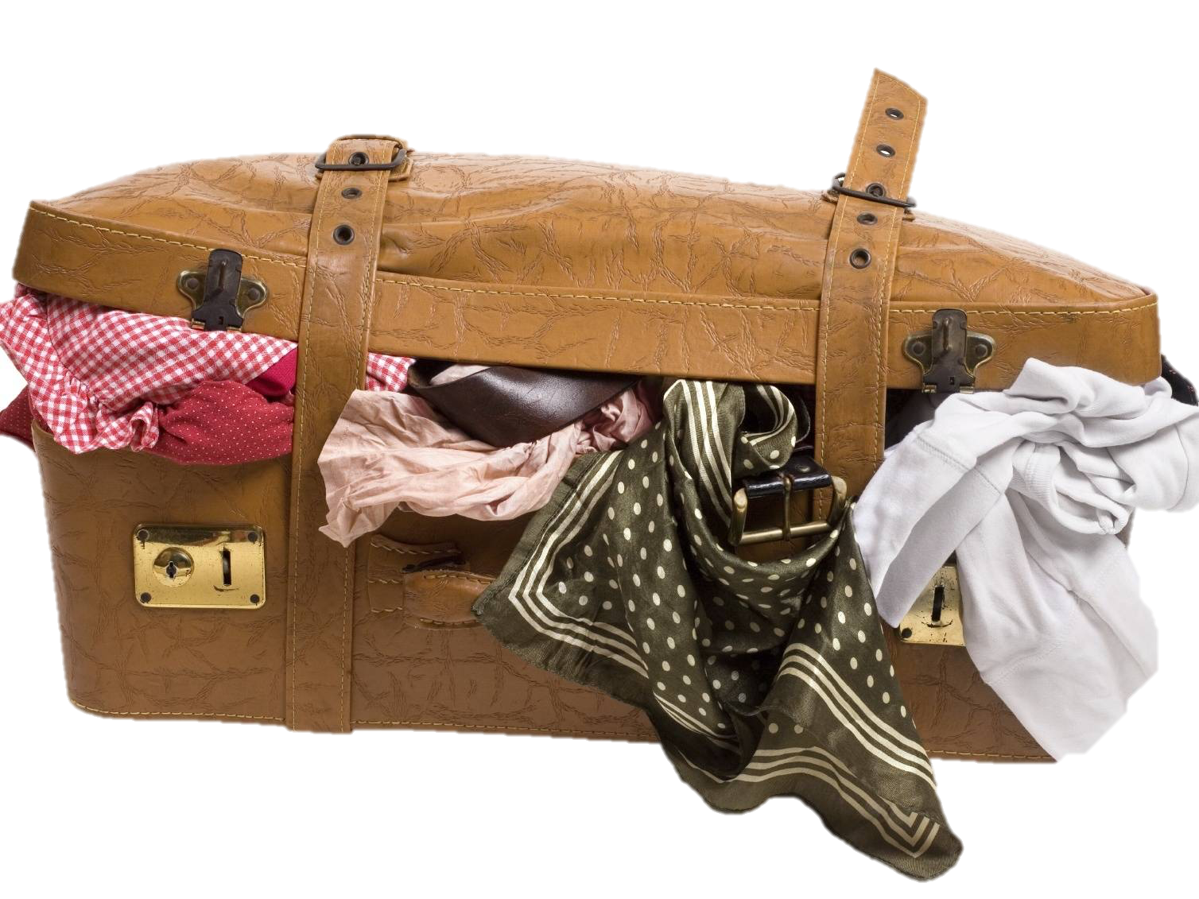
Evidence for strategically focusing learning on key forms and constructions (instead of full paradigms)
Russian and the relationship between paradigm size and number of full paradigms for nouns
There are 1-3 word forms that account for most of the frequency of any word
Those 1-3 word forms are motivated by typical grammatical constructions and collocations
In aggregate, partially overlapping subsets of forms populate the space of the paradigm
Computational experiment comparing training on full paradigms vs. single forms
Memorizing full paradigms for all words is like overstuffing your suitcase

Slide 3
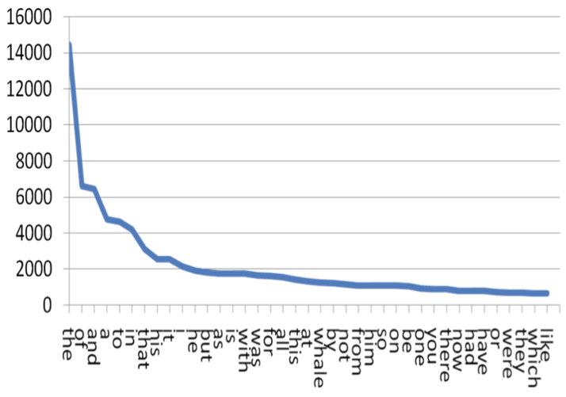
Zipf’s Law
Тhe frequency of a word is inversely proportional to its frequency rank
Zipf’s Law scales up infinitely
50% or more of all unique words are hapaxes

Slide 4
Zipf’s Law applies to word forms too
Language & Corpus Name | Corpus Size | Paradigm Size | Total Lexemes | Lexemes with full Paradigm | % Lexemes with full Paradigm
English Web Treebank | 254,830 | 2 | 6,369 | 1,524 | 23.92%
Norwegian Dependency Treebank | 311,277 | 4 | 12,587 | 393 | 3.12%
Russian SynTagRus | 1,032,644 | 12 | 21,945 | 13 | 0.06%
Czech Prague Dependency Treebank | 1,509,242 | 14 | 17,904 | 3 | 0.02%
Estonian ArborEst | 234,351 | 28 | 14,075 | 0 | 0%

Slide 5
Zipf’s Law applies to word forms too
Language & Corpus Name | Corpus Size | Paradigm Size | Total Lexemes | Lexemes with full Paradigm | % Lexemes with full Paradigm
English Web Treebank | 254,830 | 2 | 6,369 | 1,524 | 23.92%
Norwegian Dependency Treebank | 311,277 | 4 | 12,587 | 393 | 3.12%
Russian SynTagRus | 1,032,644 | 12 | 21,945 | 13 | 0.06%
Czech Prague Dependency Treebank | 1,509,242 | 14 | 17,904 | 3 | 0.02%
Estonian ArborEst | 234,351 | 28 | 14,075 | 0 | 0%
Because Zipf’s Law scales up, these numbers will never change substantially, no matter how large the corpus is

Slide 6
High-frequency Russian Nouns
‘fear’ ‘soldier’ ‘department’ ‘concept’ ‘memory’
Nsg | страх | солдат | отделение | концепция | память
Gsg | страха | солдата | отделения | концепции | памяти
Dsg | страху | солдату | отделению | концепции | памяти
Asg | страх | солдата | отделение | концепцию | память
Isg | страхом | солдатом | отделением | концепцией | памятью
Lsg | страхе |  | отделении | концепции | памяти
Npl | страхи | солдаты | отделения
Gpl | страхов | солдат | отделений | концепций
Dpl |  | солдатам
Apl | страхи | солдат | отделения | концепции
Ipl | страхами |  | отделениями | концепциями
Lpl | страхах | солдатах | отделениях
Key: bold >20%, plain >10%, grey 1-9%, (blank) unattested

Slide 7
More High-Frequency Russian Nouns
‘background’ ‘champion’ ‘extent’ ‘frame’ ‘difficulty’
Nsg | фон | чемпион |  |  | трудность
Gsg | фона | чемпиона |  |  | трудности
Dsg |  | чемпиону |  |  | трудности
Asg |  | чемпионa |  |  | трудность
Isg |  | чемпионом |  |  | трудностью
Lsg | фоне |  | протяжении
Npl |  | чемпионы |  | рамки | трудности
Gpl |  | чемпионов |  | рамок | трудностей
Dpl |  | чемпионам
Apl |  | чемпионов |  | рамки | трудности
Ipl |  | чемпионами |  | рамками | трудностями
Lpl |  |  |  | рамках | трудностях
Key: bold >20%, plain >10%, grey 1-9%, (blank) unattested

Slide 8
Masculine animates

Slide 9
Typically a lexeme is found in only 1-3 wordforms
Masculine animates

Slide 10
Typically a lexeme is found in only 1-3 wordforms
The typical wordforms
are motivated by constructions
Masculine animates

Slide 11
NomPl аналитики отмечают
‘analysts make the point that’
Typically a lexeme is found in only 1-3 wordforms
The typical wordforms
are motivated by constructions
InsSg стать/быть чемпионом
‘become/be the champion’
Masculine animates

Slide 13
High frequency nouns in Czech show the same pattern

Slide 14
LocPl volba ‘election’, podmínka ‘condition’, země ‘country’
GenPl koruna ‘crown’, dolar ‘dollar’, milión ‘million’, procento ‘percent’
LocSg případ ‘case’, základ ‘foundation’, doba ‘time period’, oblast ‘region’, kolo ‘bicycle’, trh ‘market’
High frequency nouns in Czech show the same pattern
DatPl občan ‘citizen’, podnikatel ‘businessman’, dítě ‘child’

Slide 15
Computational experiment: nouns, verbs, adjectives
Based on an ordered list of the most frequent forms in SynTagRus
Machine learning:
Given the 100 most frequent forms, predict the next 100 most frequent forms
Given the 200 most frequent forms, predict the next 100 most frequent forms
Given the 300 most frequent forms, predict the next 100 most frequent forms
Given the 400 most frequent forms, predict the next 100 most frequent forms
Given the 500 most frequent forms, predict the next 100 most frequent forms
… until 5400, when SynTagRus runs out of data

Slide 16
Computational experiment: nouns, verbs, adjectives
This is the training data
Based on an ordered list of the most frequent forms in SynTagRus
Machine learning:
Given the 100 most frequent forms, predict the next 100 most frequent forms
Given the 200 most frequent forms, predict the next 100 most frequent forms
Given the 300 most frequent forms, predict the next 100 most frequent forms
Given the 400 most frequent forms, predict the next 100 most frequent forms
Given the 500 most frequent forms, predict the next 100 most frequent forms
… until 5400, when SynTagRus runs out of data

Slide 17
Computational experiment: nouns, verbs, adjectives
This is the testing data
Based on an ordered list of the most frequent forms in SynTagRus
Machine learning:
Given the 100 most frequent forms, predict the next 100 most frequent forms
Given the 200 most frequent forms, predict the next 100 most frequent forms
Given the 300 most frequent forms, predict the next 100 most frequent forms
Given the 400 most frequent forms, predict the next 100 most frequent forms
Given the 500 most frequent forms, predict the next 100 most frequent forms
… until 5400, when SynTagRus runs out of data

Slide 18
Data for training and testing from SynTagRus
Frequency & Form | Lemma | POS | Parse of form
1447 может | мочь | VERB | Aspect=Imp|Mood=Ind|Number=Sing|Person=3|Tense=Pres|VerbForm=Fin|Voice=Act
1286 года | год | NOUN | Animacy=Inan|Case=Gen|Gender=Masc|Number=Sing
999 лет | год | NOUN | Animacy=Inan|Case=Gen|Gender=Masc|Number=Plur
832 году | год | NOUN | Animacy=Inan|Case=Loc|Gender=Masc|Number=Sing
813 время | время | NOUN | Animacy=Inan|Case=Acc|Gender=Neut|Number=Sing
678 россии | россия | NOUN | Animacy=Inan|Case=Gen|Gender=Fem|Number=Sing
571 могут | мочь | VERB | Aspect=Imp|Mood=Ind|Number=Plur|Person=3|Tense=Pres|VerbForm=Fin|Voice=Act
571 люди | человек | NOUN | Animacy=Anim|Case=Nom|Gender=Masc|Number=Plur
543 россии | россия | NOUN | Animacy=Inan|Case=Loc|Gender=Fem|Number=Sing
436 является | являться | VERB | Aspect=Imp|Mood=Ind|Number=Sing|Person=3|Tense=Pres|VerbForm=Fin|Voice=Act
416 случае | случай | NOUN | Animacy=Inan|Case=Loc|Gender=Masc|Number=Sing
411 людей | человек | NOUN | Animacy=Anim|Case=Gen|Gender=Masc|Number=Plur
403 страны | страна | NOUN | Animacy=Inan|Case=Gen|Gender=Fem|Number=Sing
400 жизни | жизнь | NOUN | Animacy=Inan|Case=Gen|Gender=Fem|Number=Sing

Slide 19
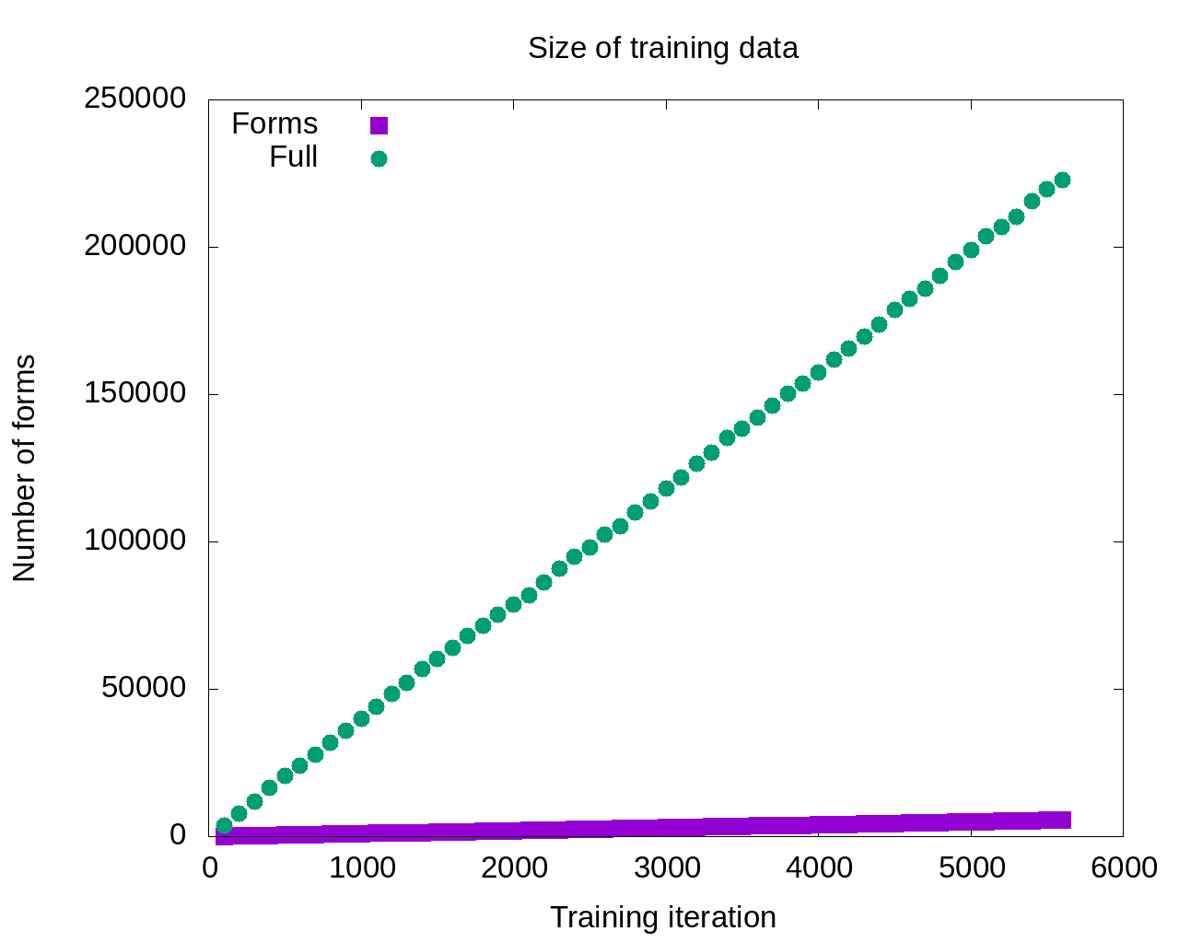

Slide 20
So the model that gets the most input should be the most successful, right?

Slide 21
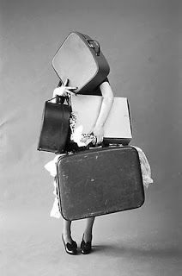
Maybe not…
So the model that gets the most input should be the most successful, right?

Slide 22
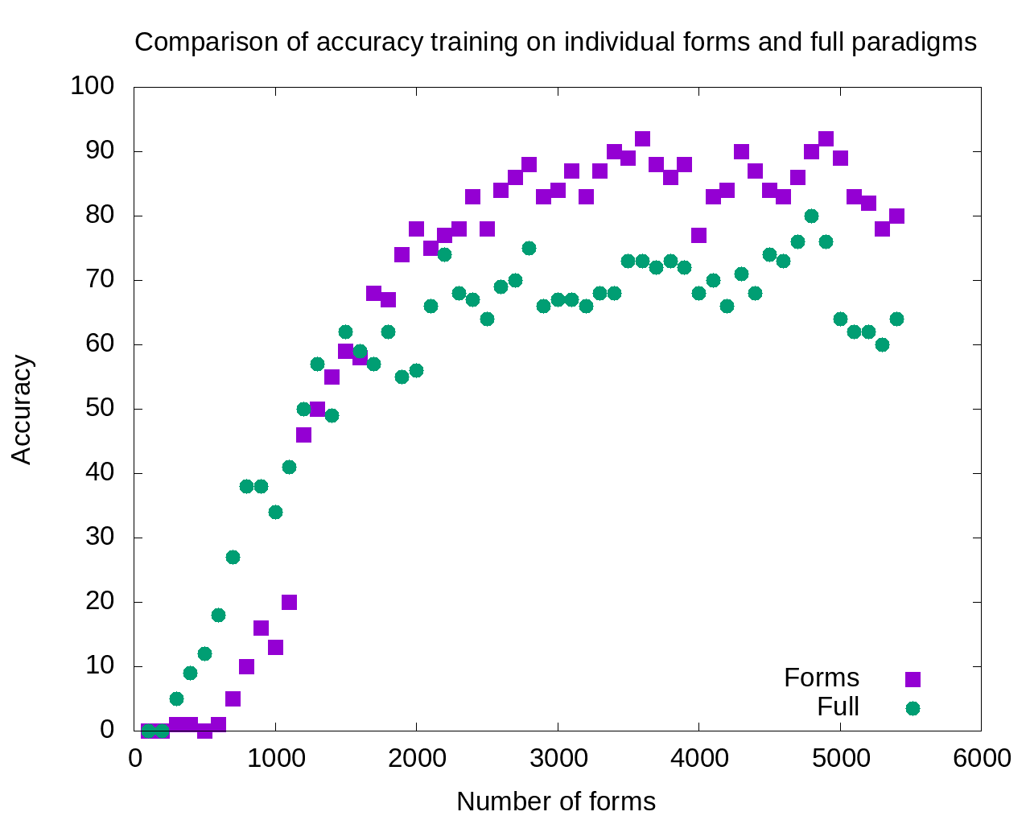

Slide 23
1800-5400:
Single forms model outperforms
full paradigms

Slide 24
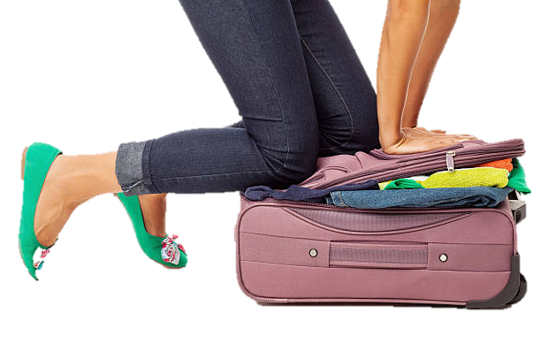
Excess data is probably overpopulating the search domain

Slide 25
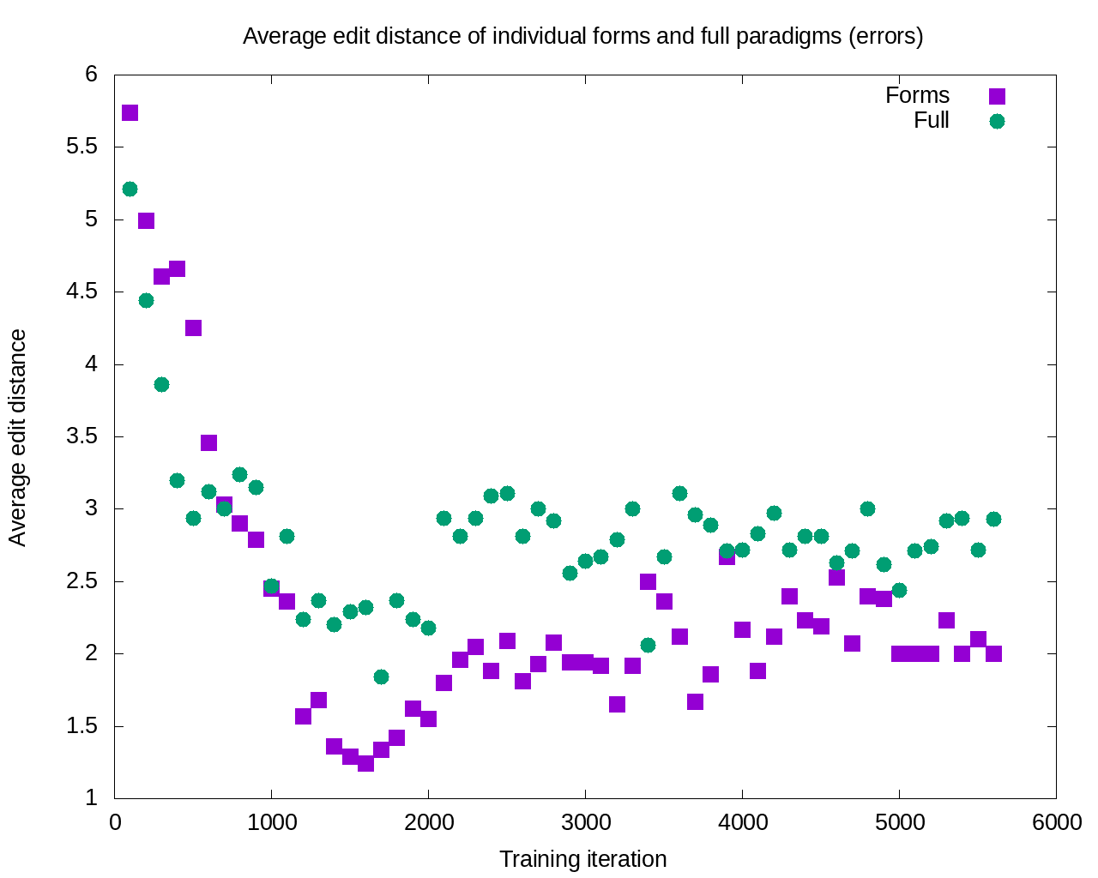

Slide 26
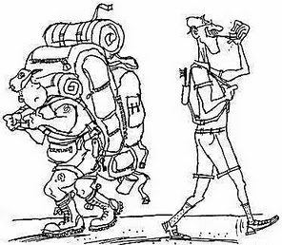
After 11 iterations, the errors committed by the single forms model are consistently smaller

Slide 27
What this means
A given word typically appears in only a handful of forms
Those word forms are motivated by constructions and collocations most typical for the word
Learning is potentially enhanced by focus only on the most typical word forms attested for given lexemes: accuracy increases and severity of errors decreases

Slide 28
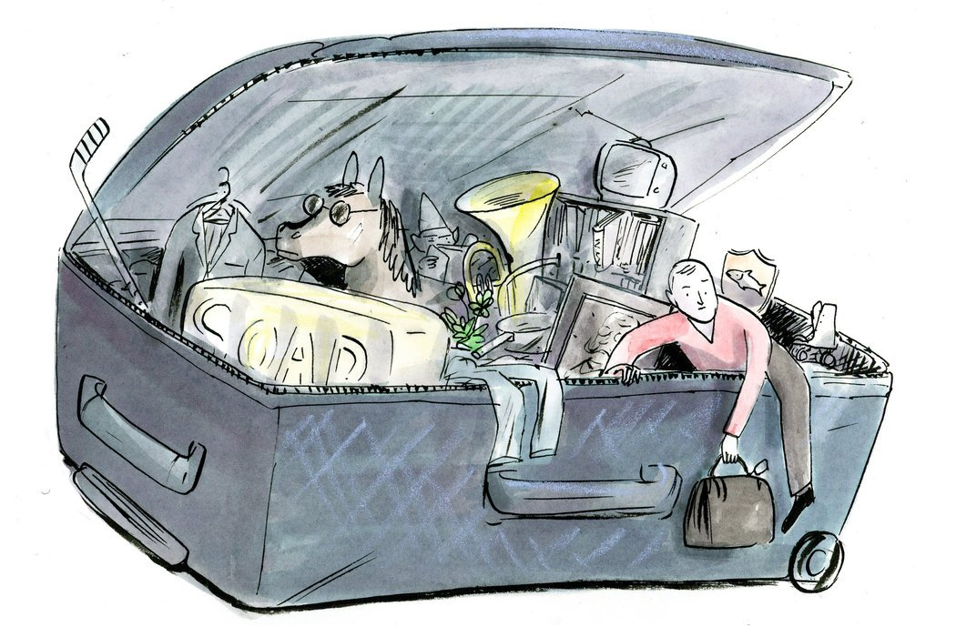
So how can we escape from this overstuffed suitcase?
Textbooks have always focused on certain forms and constructions
Now we can do this in a scientific, consistent way

Slide 29

Find the 1-3 most common forms of the high-frequency words students need to know
Find the grammatical constructions and collocations that motivate those 1-3 word forms

Slide 30

What can we do?
Thank you!
Use corpora to find the most strategic word forms and the constructions and collocations that motivate those word forms
Build learning materials that focus on the typical word forms, avoiding unlikely word forms, for example the Russian Constructicon and the Strategic Mastery of Russian SMARTool

